Slide 1
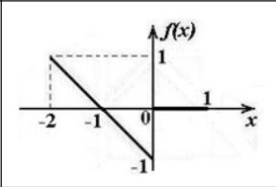
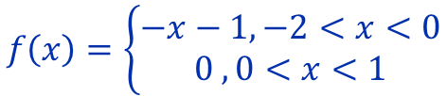
Задание №4
$$f\left(x\right)=\left\{\begin{aligned}−x−1, −2<x<0 \\ 0 , 0<x<1\end{aligned}\right.$$
1

Slide 2
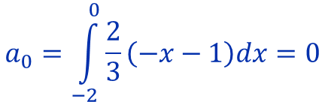

Задание №4
$$f\left(x\right)=a_{0}+\sum_{n=1}^{∞}{\left(a_{n}\cos{\frac{2nπx}{3}}+b_{n}\sin{\frac{2nπx}{3}}\right)}$$
$$a_{0}=\int_{−2}^{0}{\frac{2}{3}\left(−x−1\right)dx}=0$$
2

Slide 3

$$a_{n}=\frac{2}{3}\int_{−2}^{0}{(−x−1)cos}\left(\frac{2πnx}{3}\right)dx=$$
$$=\frac{2}{3}(\int_{−2}^{0}{−xcos\left(\frac{2πnx}{3}\right)dx+}\int_{−2}^{0}{−\cos\left(\frac{2πnx}{3}\right)dx)=}$$
$$=\frac{2}{3}(\frac{−xsin(\frac{2πnx}{3})}{\frac{2πn}{3}}|_{−2}^{0}−\frac{\sin\left(\frac{2πnx}{3}\right)}{\frac{2πn}{3}}|_{−2}^{0}+\int_{−2}^{0}{\frac{\sin\left(\frac{2πnx}{3}\right)}{\frac{2πn}{3}}dx})=$$
$$=\frac{2}{3}(\frac{−xsin\left(\frac{2πnx}{3}\right)}{\frac{2πn}{3}}|_{−2}^{0}−\frac{\sin\left(\frac{2πnx}{3}\right)}{\frac{2πn}{3}}|_{−2}^{0}+\frac{\cos\left(\frac{2πnx}{3}\right)}{{\left(\frac{2πn}{3}\right)}^{2}}|_{−2}^{0})=$$
$$=\frac{2}{3}\left(\frac{\sin\left(\frac{4πn}{3}\right)}{\frac{2πn}{3}}−\frac{1}{({\frac{2πn}{3})}^{2}}+\frac{\cos\left(\frac{4πn}{3}\right)}{{\left(\frac{2πn}{3}\right)}^{2}}\right)$$

Slide 4

$$b_{n}=\frac{2}{3} \left(\int_{−2}^{0}{\left(−x−1\right)sin}\left(\frac{2πnx}{3}\right)dx\right)=$$
$$=\frac{2}{3}\left(\int_{−2}^{0}{−xsin}\left(\frac{2πnx}{3}\right)dx+\int_{−2}^{0}{−sin}\left(\frac{2πnx}{3}\right)dx\right)=$$
$$=\frac{2}{3}(\frac{xcos\left(\frac{2πnx}{3}\right)}{\frac{2πn}{3}}|_{−2}^{0}+\frac{−xsi\left(\frac{2πnx}{3}\right)}{\frac{2πn}{3}}|_{−2}^{0}+\int_{−2}^{0}{−\cos\left(\frac{2πnx}{3}\right)dx)=}$$
$$=\frac{2}{3}\left(\frac{xcos\left(\frac{2πnx}{3}\right)}{\frac{2πn}{3}}|_{−2}^{0}+\frac{−xsin\left(\frac{2πnx}{3}\right)}{\frac{2πn}{3}}|_{−2}^{0}+\frac{\cos\left(\frac{2πnx}{3}\right)}{\left(\frac{2πn}{3}\right)}|_{−2}^{0}\right)=$$
$$=\frac{2}{3}\left(\frac{sin\left(\frac{4πn}{3}\right)}{{\left(\frac{2πn}{3}\right)}^{2}}+\frac{1}{\left(\frac{2πn}{3}\right)}+\frac{cos\left(\frac{4πn}{3}\right)}{\left(\frac{2πn}{3}\right)}\right)$$

Slide 5
Ссылка к desmos

Slide 6
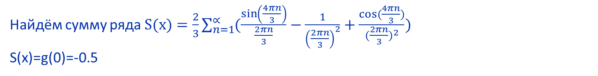
Найдём сумму ряда $S(x)=\frac{2}{3}\sum_{n=1}^{∝}{(\frac{\sin\left(\frac{4πn}{3}\right)}{\frac{2πn}{3}}−\frac{1}{{\left(\frac{2πn}{3}\right)}^{2}}+\frac{cos⁡(\frac{4πn}{3})}{{(\frac{2πn}{3})}^{2}})}$
S(x)=g(0)=-0.5

Slide 7
Вывод:
Если мы можем найти исходную функцию, то будет легче найти сумму сложного ряда.

